Slide 1
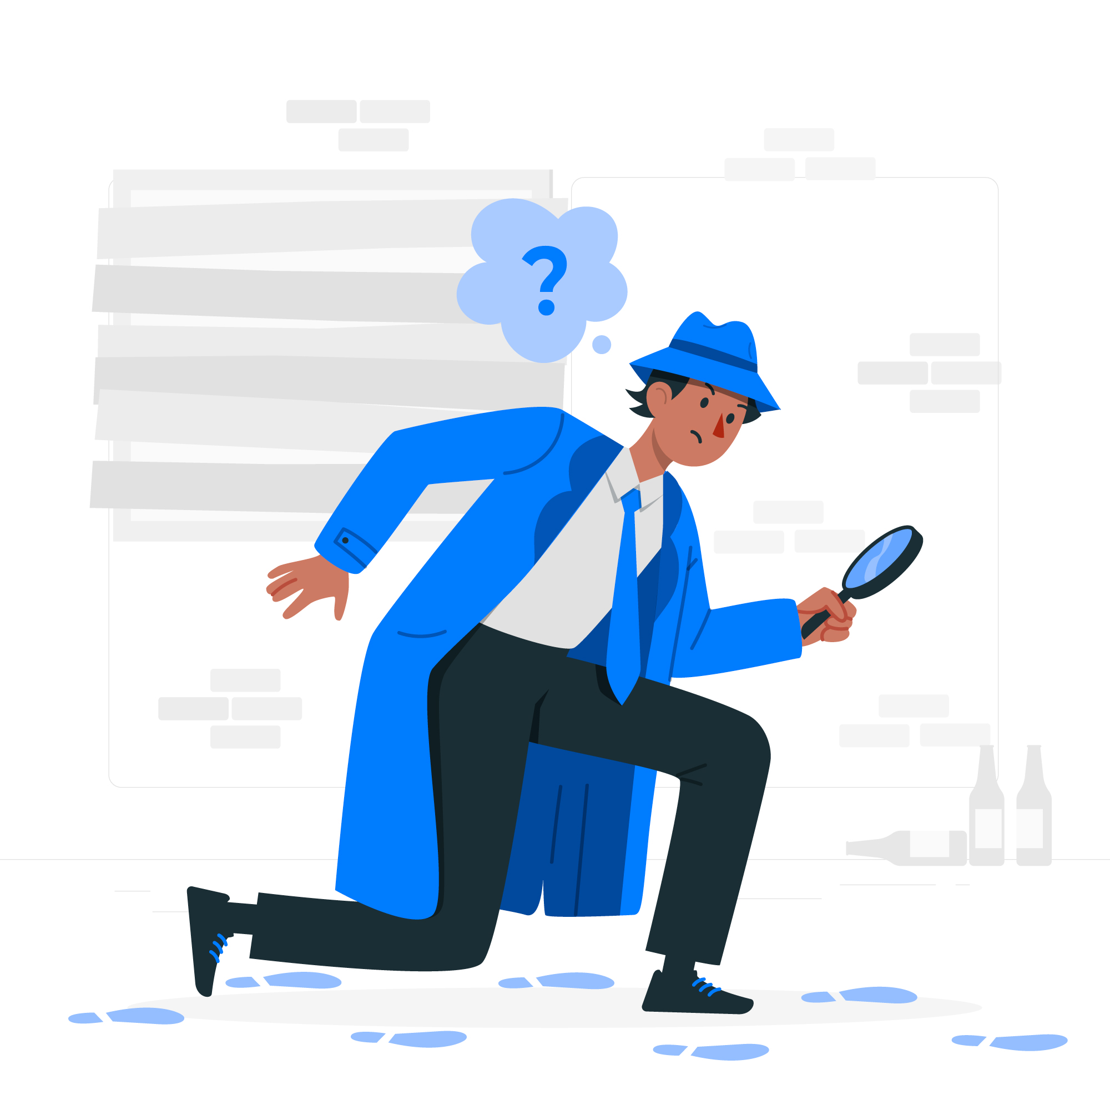

Be a Data Science and AI Health Detective
Discover What Your Body's Telling You Through Data!
Instructor: Shri Harini Ramesh
April 28 – May 2, 2025

Slide 2
About me

Slide 3


2017-2021
B.Eng in Biomedical Engineering

Slide 4


2021-2023
MASc in Biomedical Engineering

Slide 5

PhD in Biomedical Engineering

Slide 6
My Research

Slide 7
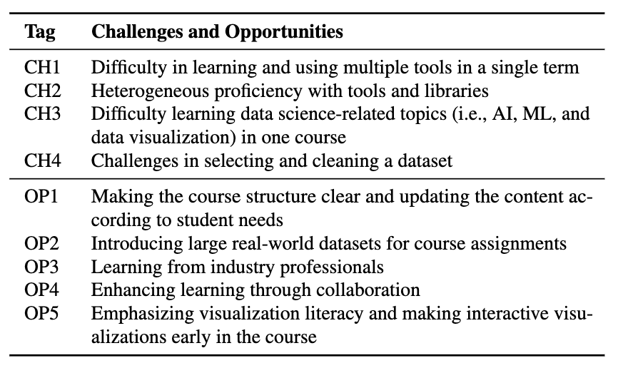
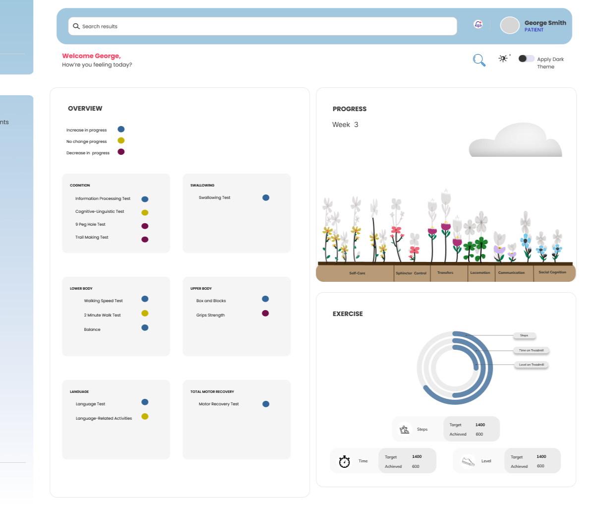
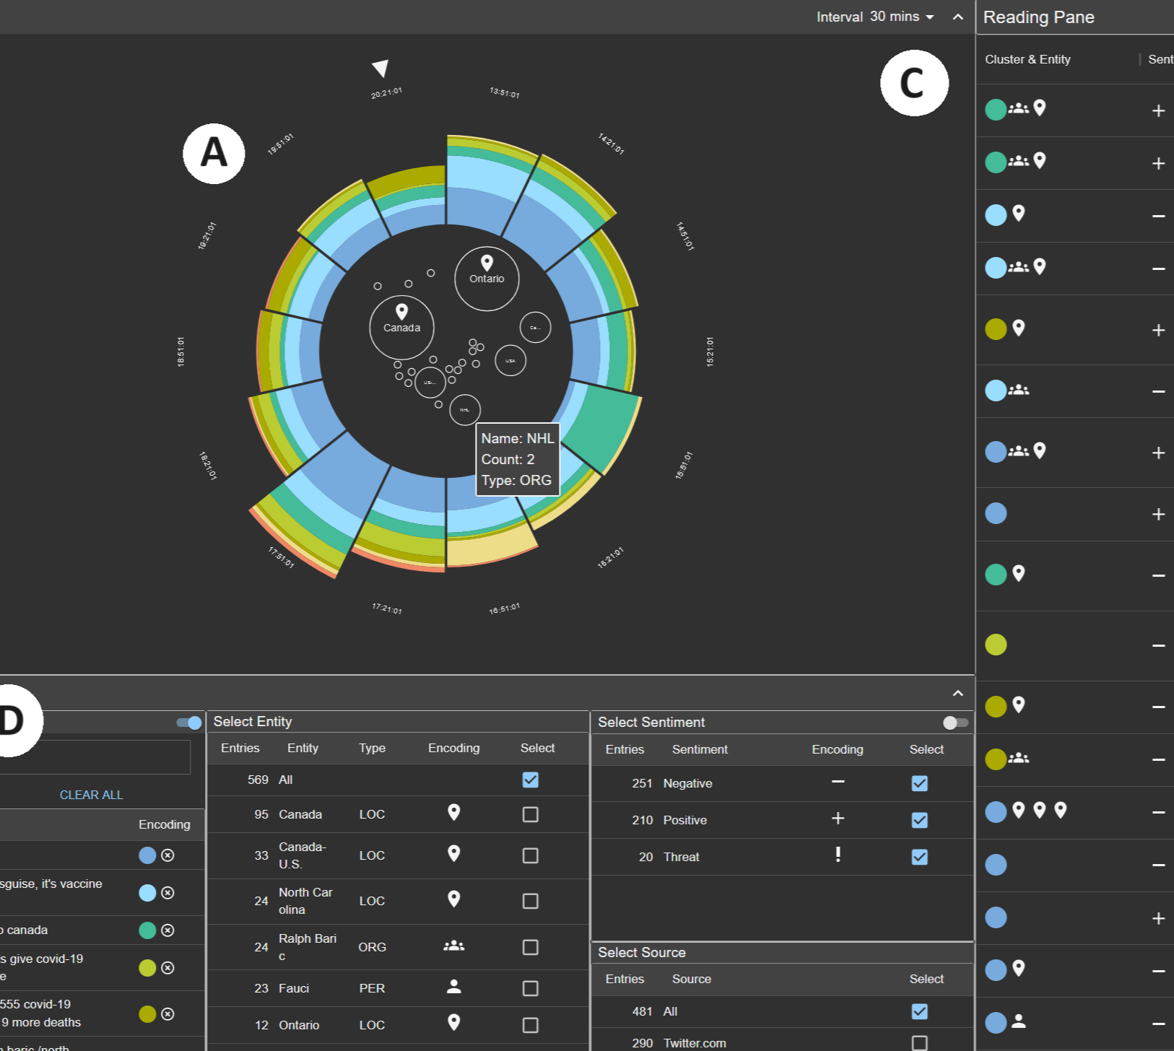
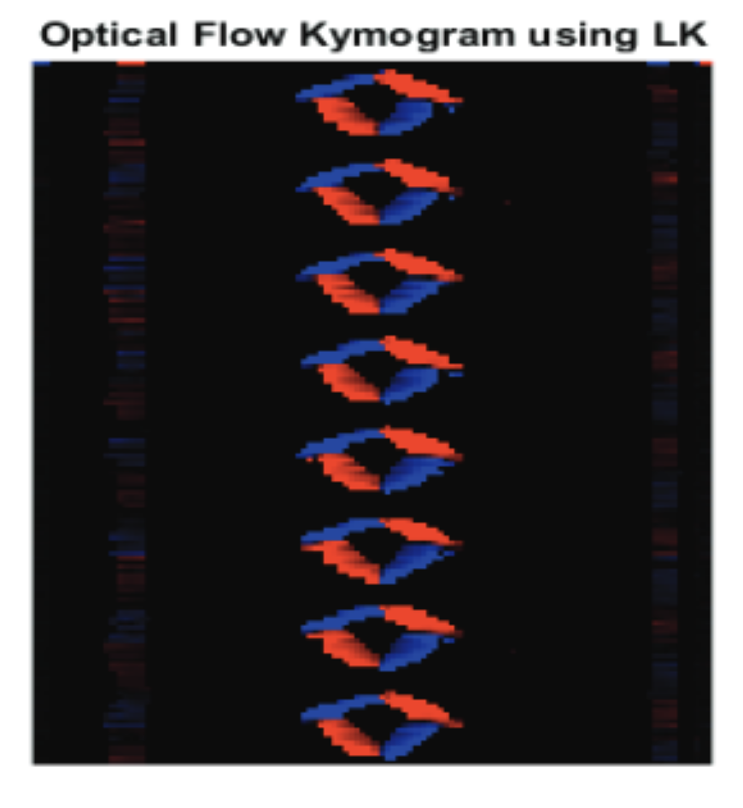
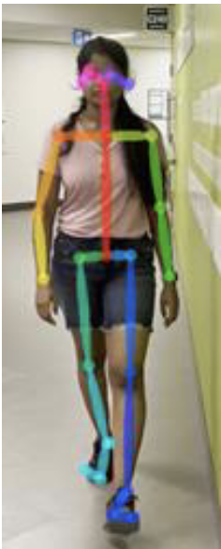
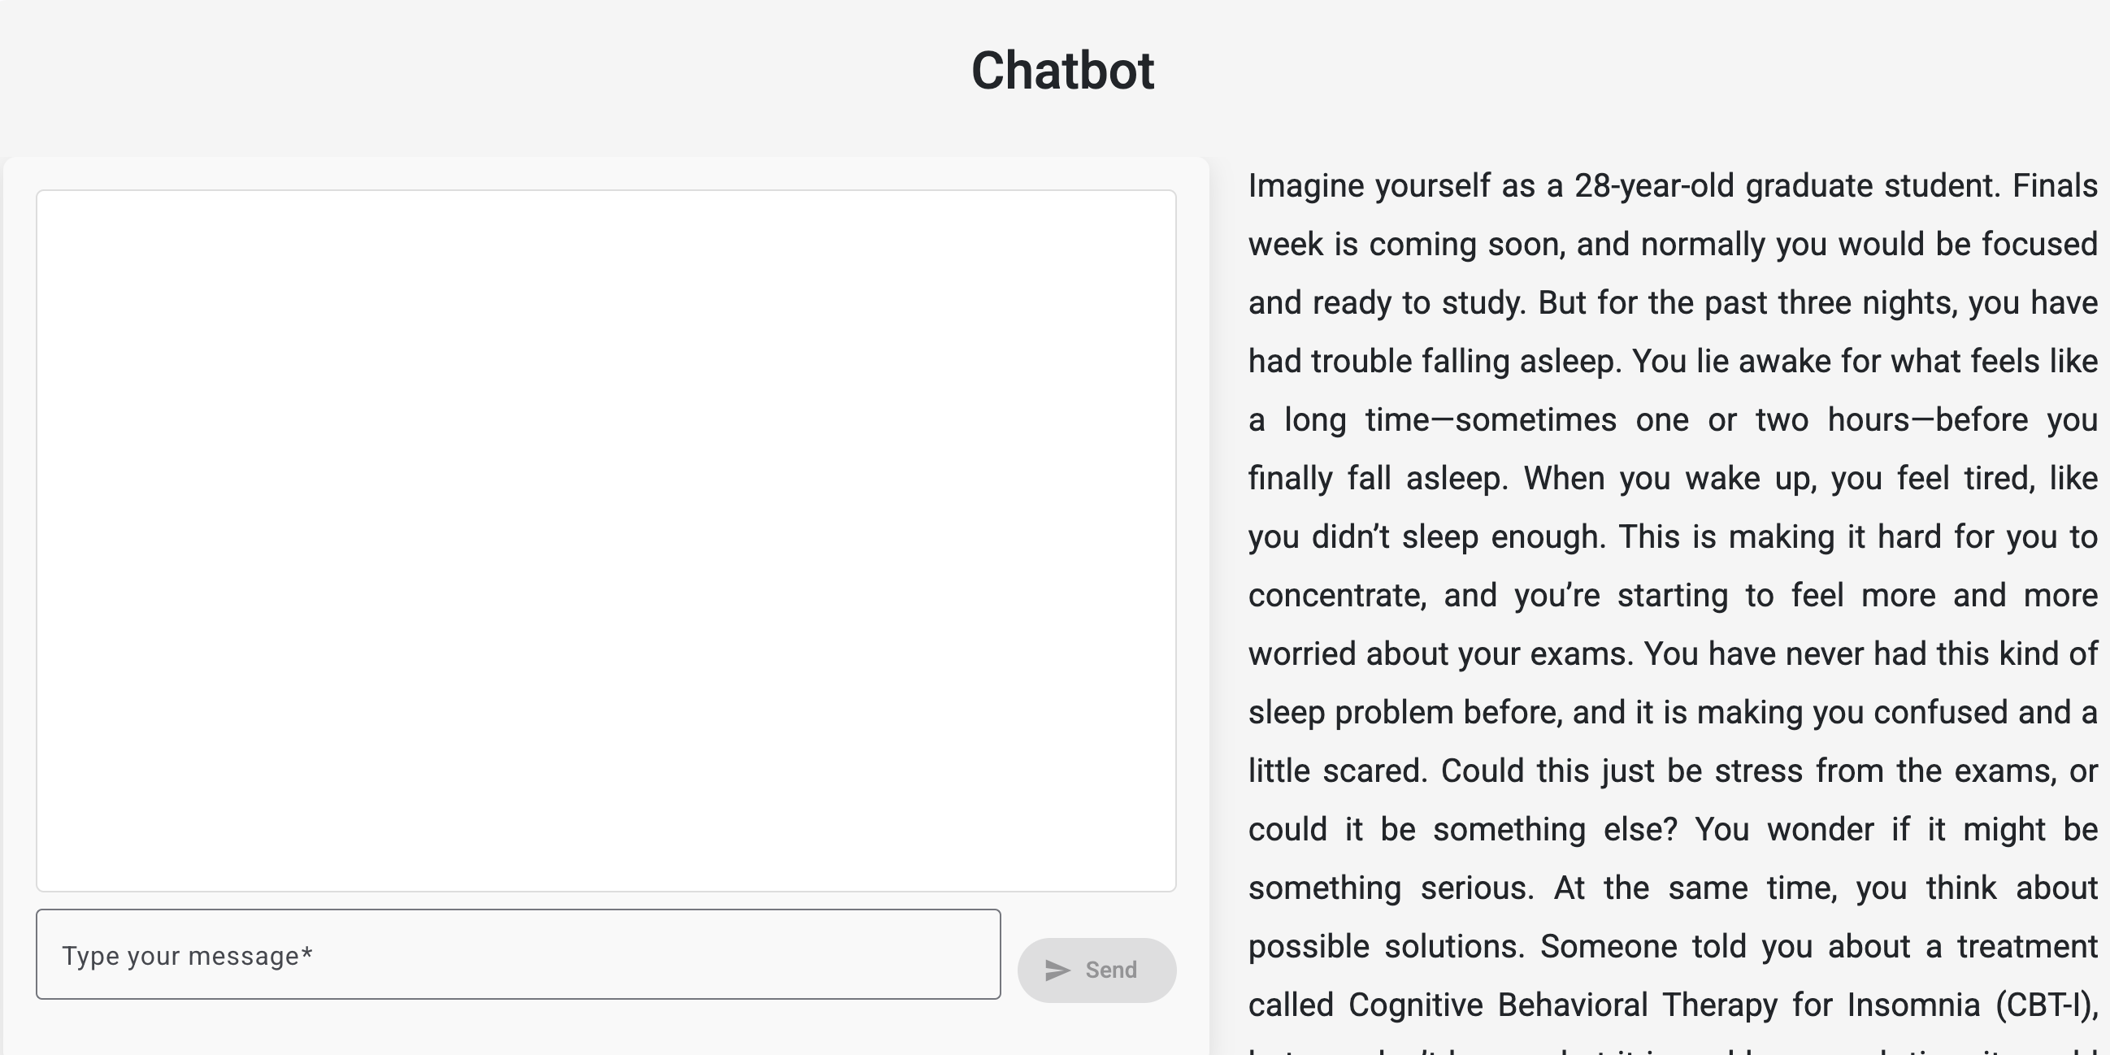
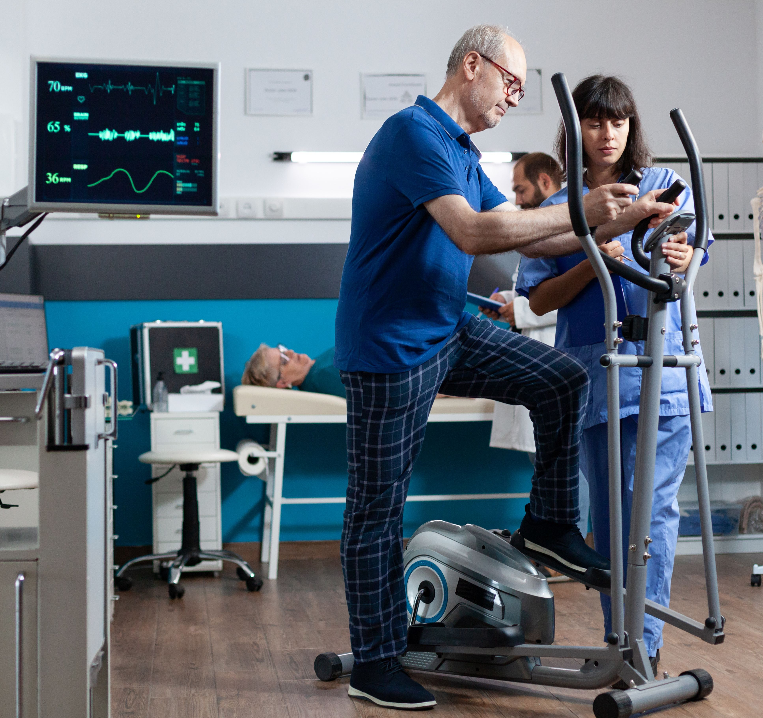
Data Viz
AI
Health

Slide 8
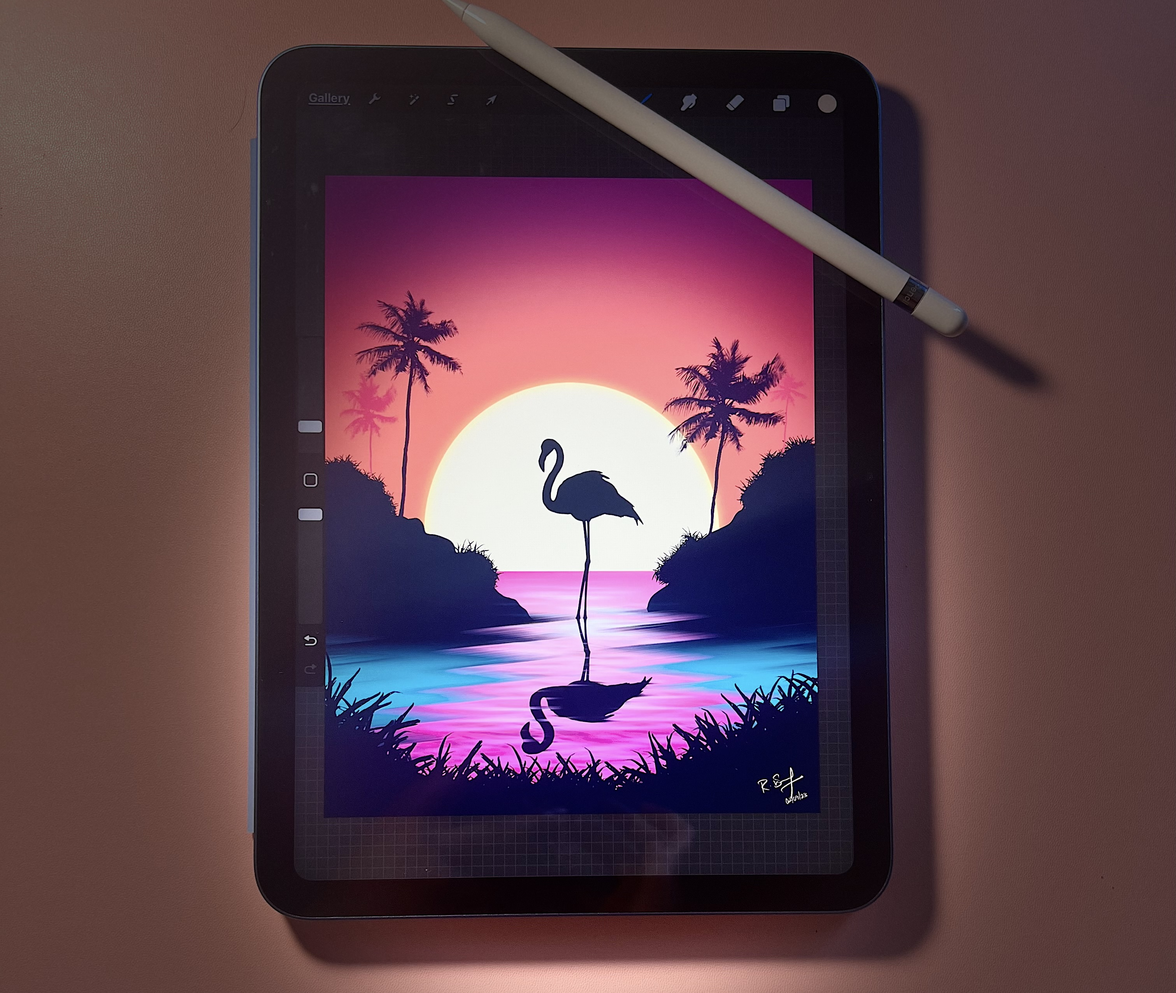
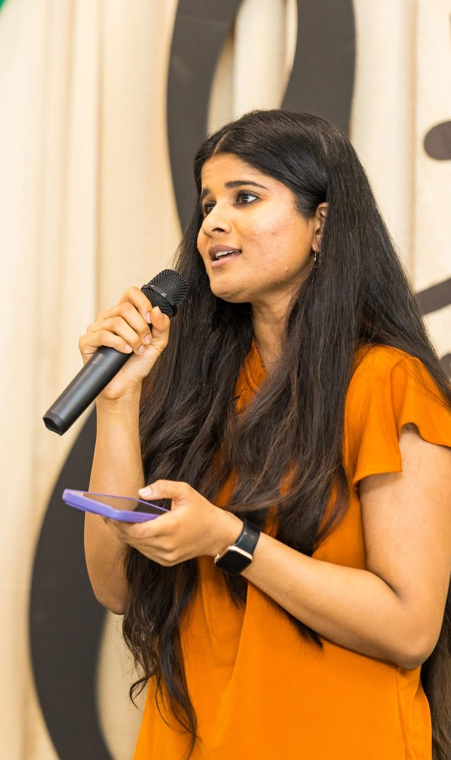

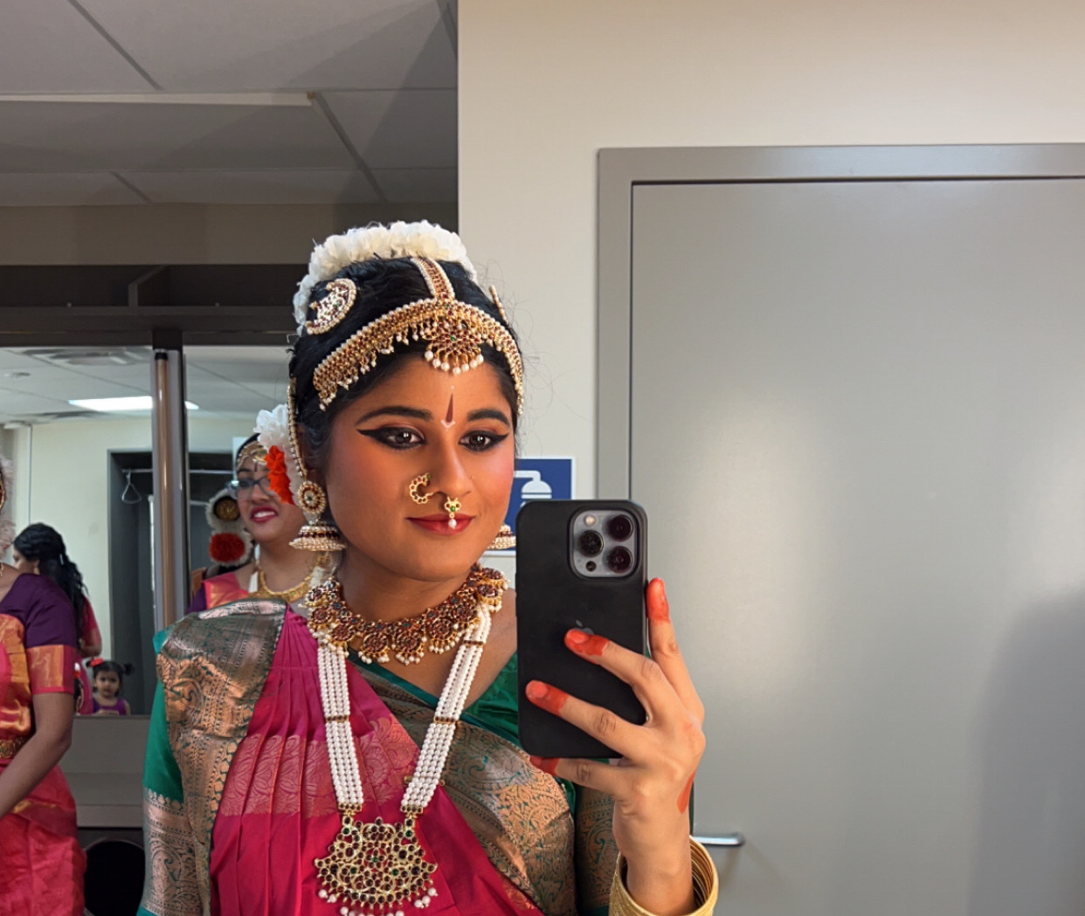

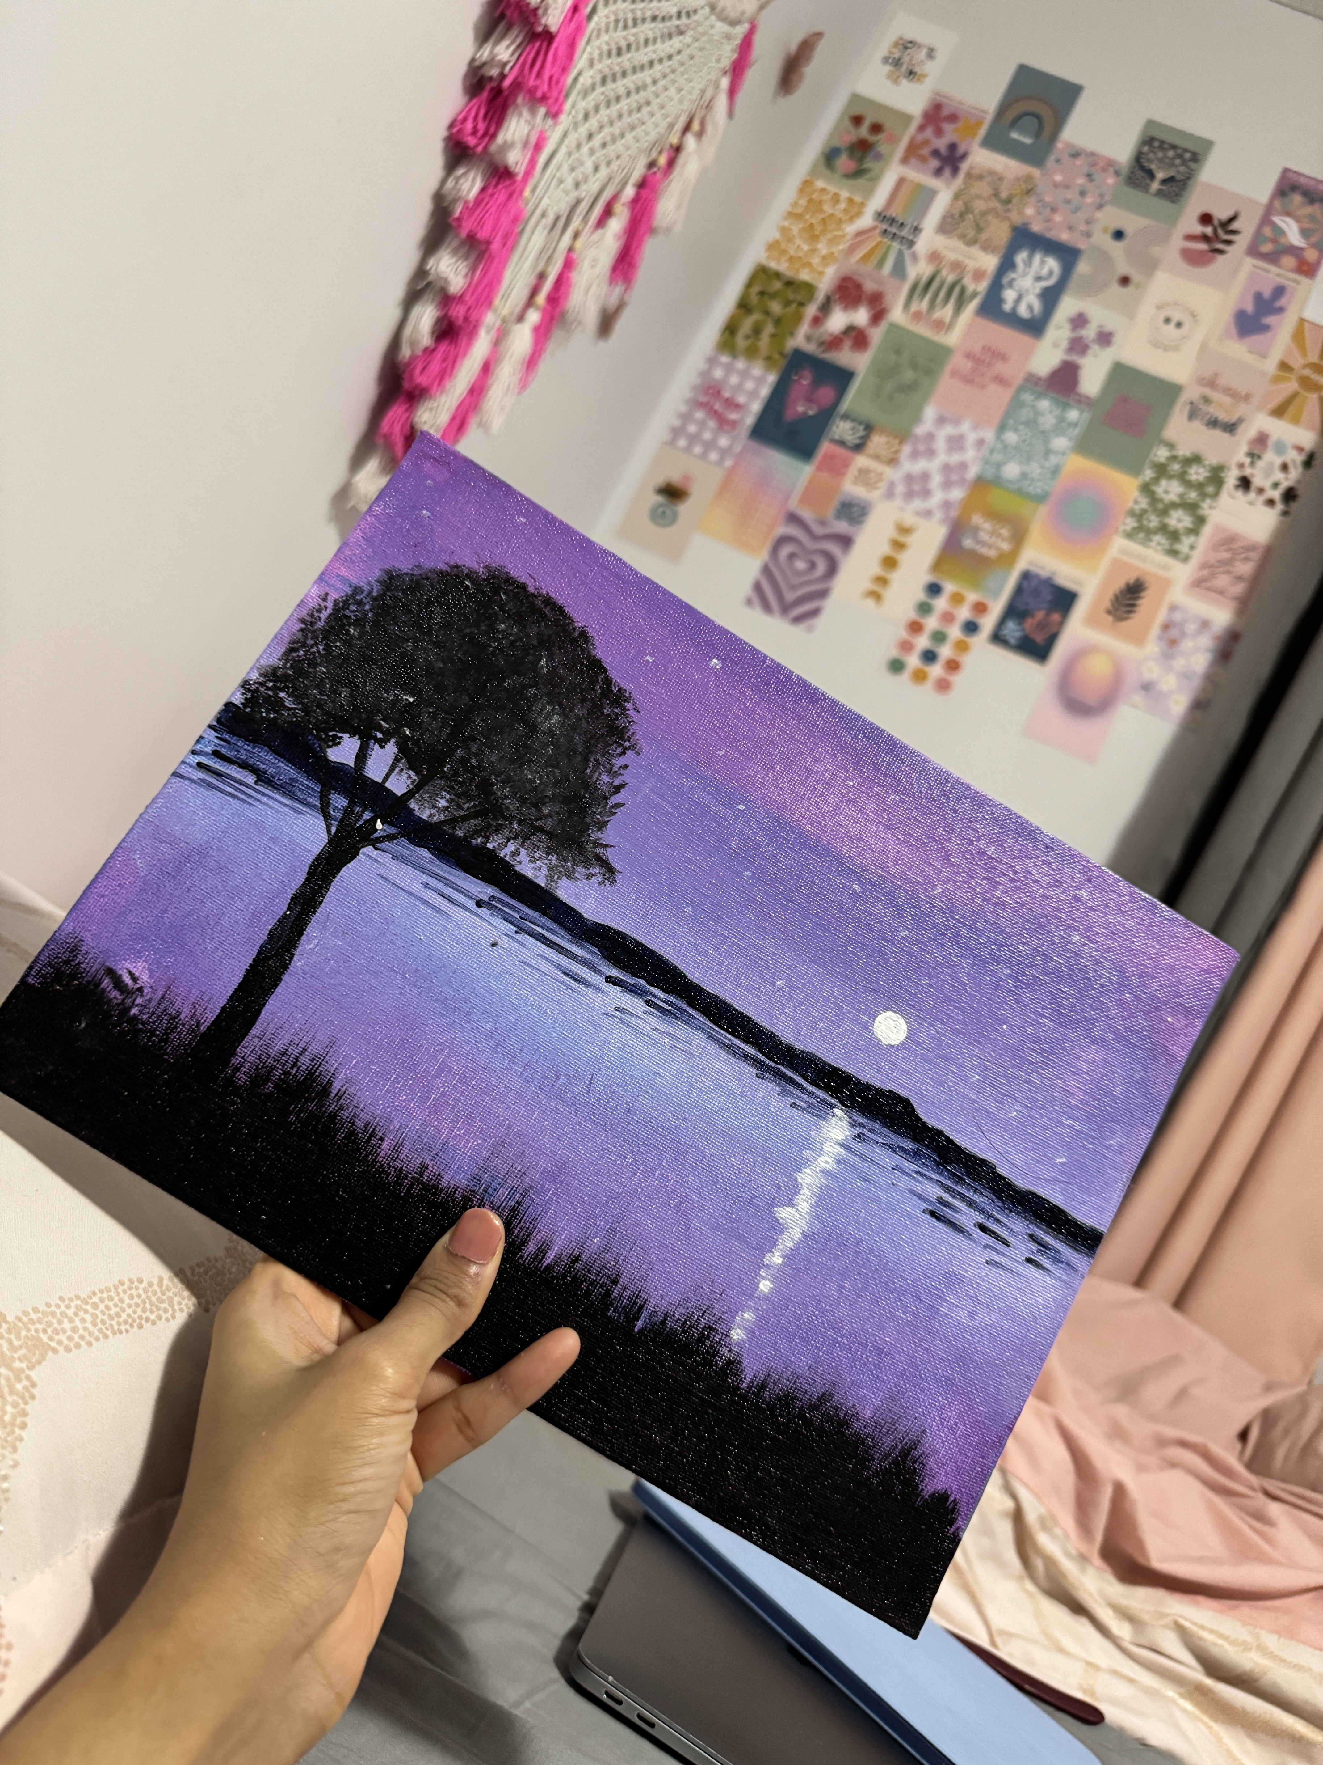
Some other things I do

Slide 9
About the Course

Slide 10
What’s This Course About?
Ever wonder what your smartwatch (or phone) knows about your health?
In this course, you’ll explore your own data like steps, sleep, and heart rate
No wearable? No problem — We can explore other ways to collect data!

Slide 11
What Will You Do?
Track your own daily health habits
Turn numbers into colorful charts and visuals
Discover patterns in your health
Learn how small changes can boost your energy and wellness

Slide 12
Your Big Project!
By the end of the course, you’ll build a:
🎯 Personal Health Dashboard
Like the ones athletes and scientists use — made by YOU!

Slide 13
What Will You Learn?
By the end of this course, you’ll be able to:
👉 Analyze your health data like a pro!
Let’s break it down…

Slide 14
What Will You Learn?
🏃 Identify and describe different types of personal health data
📝 Collect, clean, and organize personal health data
🤖 Apply artificial intelligence techniques to analyze personal data
🎨 Design and develop effective visual presentations of personal health data for exploration and communication
💡 Draw insights from data to reflect on personal health habits

Slide 15
How to Access the Materials?

Slide 16
https://datascience4health.netlify.app/

Slide 17
Let’s Talk Expectations

Slide 18
🛑 Need to Step Out?
Washroom? No problem
Just quietly step out and come back in

Slide 19
💻 Using Devices
Phones & laptops are welcome for activities and research
During group chats or focused discussions, I’ll ask for your full attention

Slide 20
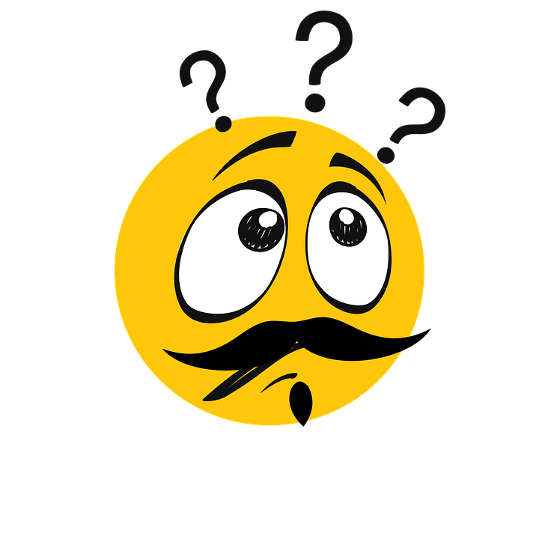

Slide 21
Let’s Get to Know Each Other

Slide 22
Tell us your name
Share one fun/weird/random fact about you!
If you tracked your health data for a week…
🕵️‍♀️ What might you discover about yourself?

